Slide 1


Fundamentals of RM
RM System and Process
Leadership in RM
Incident Investigation
RM Tools & Challenges
RM in Industry
People & Org.
Application and Perspectives
On Becoming a
Leader in Risk Management
ENGG404 - Lecture
Chapter 5.8:
Job Observations &
Planned Inspections (Audits)

Slide 2
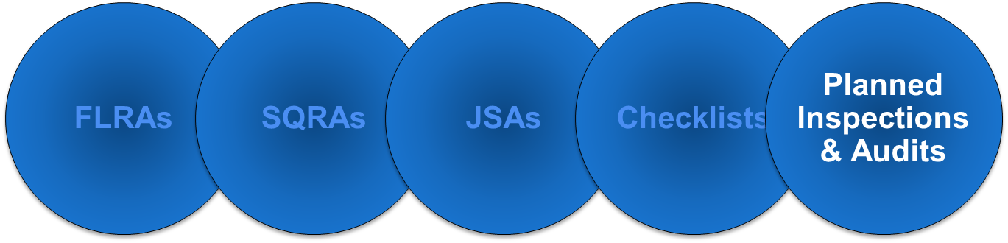
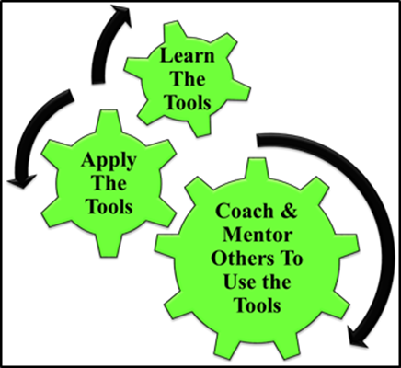
Learning Outcomes:
Apply JO & PI Method to create a Planned Inspection Checklist.
Apply JO & PI Checklist to use, interpret, critique, and check the compliance of physical conditions in the work-place or the practices of work-in-progress.
Apply JO & PI Method as a rudimentary leadership skill to observe, interact, check, commend, or intervene / coach
employees in the work-place i.e. at the individual
level or the team (crew, work-group) level.
A leader’s job is to
coach and mentor!
“Leverage”!
Chapter 5.8: Job Observations & Planned Inspections (Audits)
2
Notes:
2

Slide 3
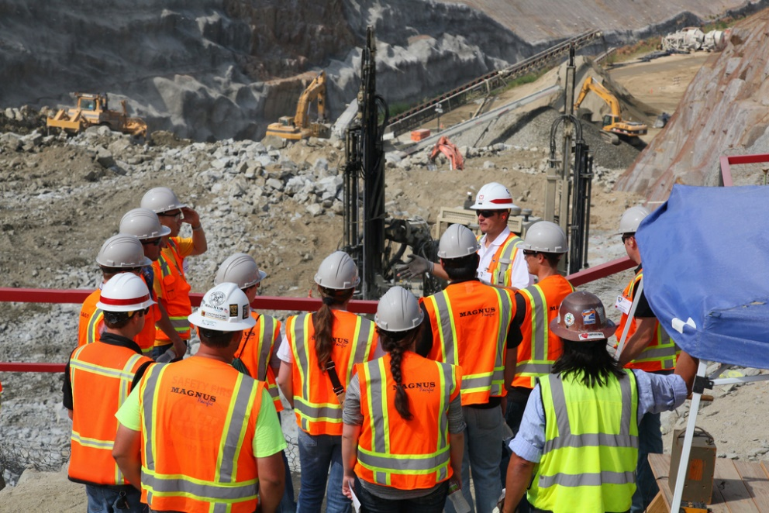
Why Do We Do Job Observations and Planned Inspections?
Orientation and integration for new employees and contractors
To ensure adequate and effective administrative controls
For training purposes
For combatting complacency
Chapter 5.8: Job Observations & Planned Inspections (Audits)
3
Notes:
3

Slide 4
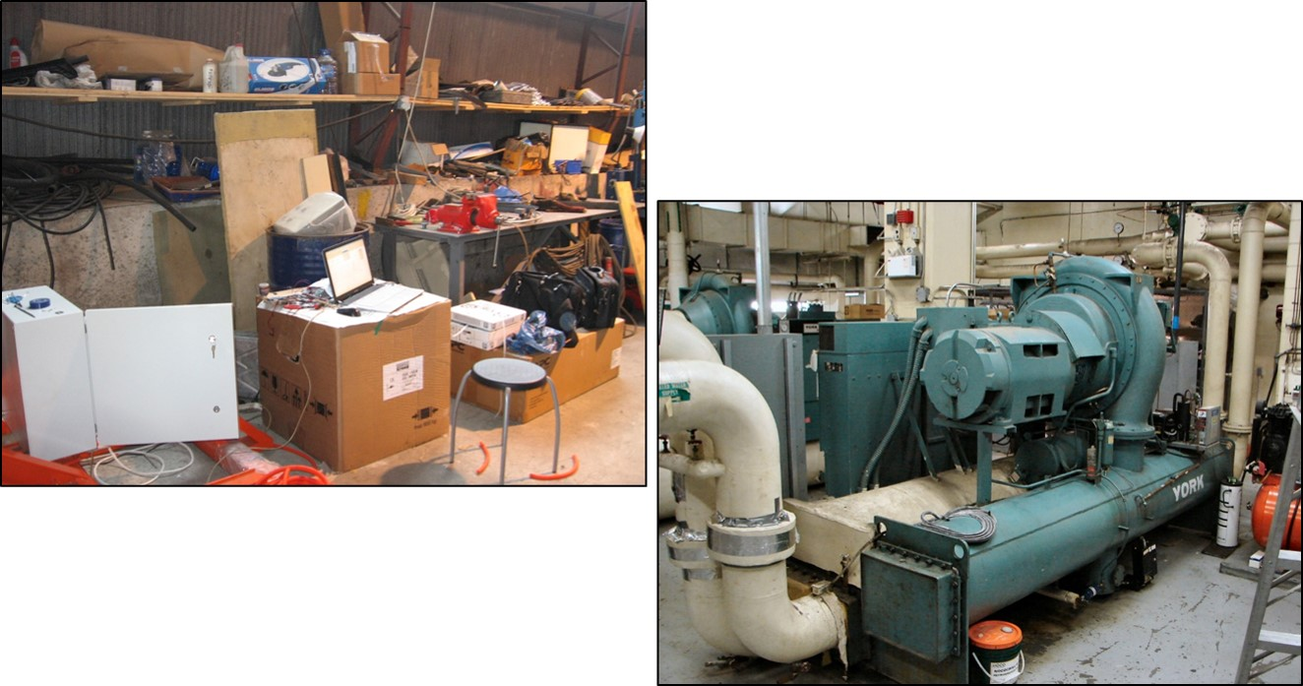
Introduction:
Two different kinds of a Planned Inspection:
  Physical conditions in the workplace
  Practices of work-in-progress
Easy to do!
Chapter 5.8: Job Observations & Planned Inspections (Audits)
4
Notes:
4

Slide 5



Introduction:
Two different kinds of a Planned Inspection:
  Physical conditions in the workplace
  Practices of work-in-progress (to observe, interact, check)
    At the Individual Level (the manager and the worker) or
    At the Team Level (the manager and a team i.e. a crew or shift or group of workers).
Challenging!
Chapter 5.8: Job Observations & Planned Inspections (Audits)
5
Notes:
5

Slide 6
Why is it Challenging to do Planned Inspections:
It is challenging to do planned inspections i.e. to inspect / audit practices of work-in-progress (to observe, interact, check) because:
    We typically and naturally do not know how to do this effectively.
    It is uncomfortable for us to “confront” a worker.
    Take any “people-skills” training on how to observe, interact, and coach workers at your employer – in-line with the culture of your employer.
    This will support your becoming a leader!
Chapter 5.8: Job Observations & Planned Inspections (Audits)
6
Notes:
6

Slide 7


Planned Inspection of Work Practices:
Inspect / audit practices of work-in-progress (to observe, interact, check)
    At the Individual Level (the manager and the worker) or
    At the Team Level (the manager and a team i.e. a crew or shift or group of workers).
Think back to your work experiences …
    Did your supervisor or any other manager approach you and your work crew, and ask questions about hazards and risks on the job, about any control measures such as the FLRA, Procedures, or Permit-to-Work?
    Was it a positive, productive experience?
If the answers to these questions are
yes, then you were working in a
leading organization!
The leader was doing their job!
Chapter 5.8: Job Observations & Planned Inspections (Audits)
7
Notes:
7

Slide 8
JO & PI as a Means to Combat Complacency:
Complacency – the acceptance of SCs and SPs in the workplace
Complacency sets in when:
Workers become accustomed to and comfortable with the operations, facility, equipment, procedures, and work processes.
This comfort level leads to complacency.
The workers may begin to take “short-cuts” with practices
and/or conditions.
The manager can – and must – combat complacency:
Planned inspections check for compliance AND
act to correct deviations.
Face-to-face coaching to be empowered to address sub-standard conditions and at-risk behaviours …
Positively influence safety culture of the organization.
Chapter 5.8: Job Observations & Planned Inspections (Audits)
8
Notes:
8

Slide 9

JO & PI as a Means to Combat Complacency:
Limitations and Drawbacks of Checklists:
Too narrow: does not cover every anticipated need or every situation.
If not carefully observant, hazards / deficiencies can be overlooked.
To overcome these drawbacks, checklists become longer:
… and it becomes a perfunctory fashion (so called “checking the boxes” or “pencil whipping exercise”).
Outcome: The impact on culture is complacency!
Complacency sets in with repeated use and lack of leadership support;
thus, an opportunity for leadership in risk management.
Complacency: “normalization of deviation”, “atrophy of vigilance”,
“numb to risk”, the casual acceptance of unacceptable risk levels.
This an opportunity for leadership.
So, what can leaders do to combat complacency?
Let’s explore this question.
Chapter 5.6: Checklists for Executing Work
9
Notes:
9

Slide 10
Planned Inspections and Audits:
Planned Inspections and Audits – What is the Difference?
No difference:
Planned
Looking for deviations and deficiencies!
“Audit” can have negative connotations
In the context of risk management:
A Planned Inspection at the Individual / Team Level checks the work practices in real-time with interactions with workers
An Audit checks the integrity of specific components of the risk management system and program – more is discussed in the topic on RME #6 PECI.
Chapter 5.8: Job Observations & Planned Inspections (Audits)
10
Notes:
10

Slide 11
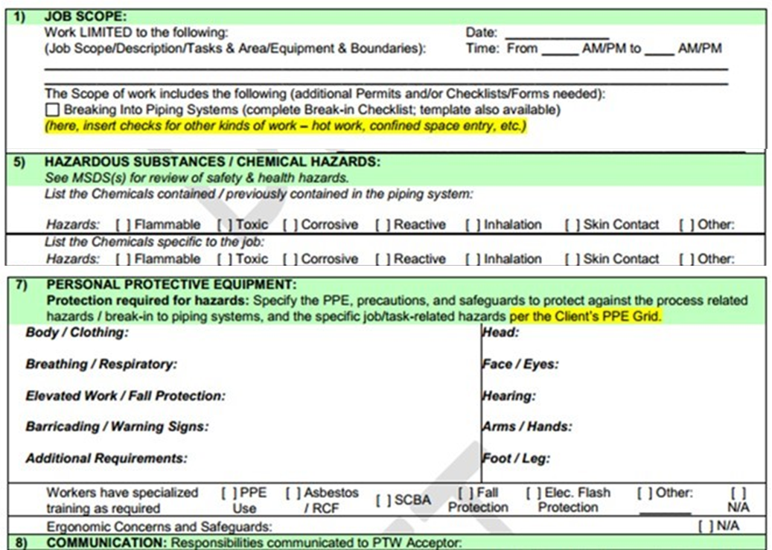
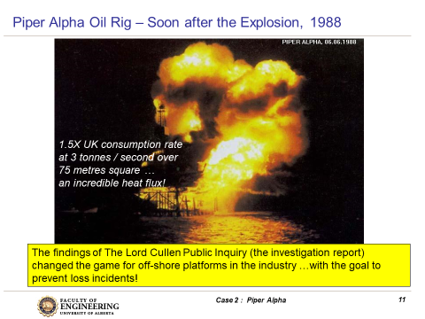
Audits on Critical Administrative Controls:
Recall PTWs and the Piper Alpha LI?
The PTW and its associated safety
rule / procedure / policy / protocol
are critical administrative controls!
The PTW is a component of a RMS,
and specifically under RME #2 RA&MR
Deviations from the PTW checklist indicate
a risk level may be or is higher than the
acceptable level.
The PTWs were not managed properly,
and were treated as a mere “formality”;
thus, the risks associated with putting
equipment back on-line without thorough
checks resulted in “unchecked” risks and
hazards, with tragic losses on PEAP.
Chapter 5.8: Job Observations & Planned Inspections (Audits)
11
Notes:
11

Slide 12
Example: Audit on the PTW at Piper Alpha:
If you were a manager on Piper Alpha, what would you do to combat complacency about the use of the PTW, a critical administrative control? All of the items listed!
Indeed, an audit using an audit checklist on the PTW would combat complacency about the use of the PTW, a critical administrative control.
It is NOT simply the audit check-list; that is a required starting point.
It is about applying the audit checklist to confirm that work is being executed as it should!
Create an audit checklist that specifies the items to check on a PTW. The PTW Audit checklist will look similar to the actual PTW checklist.
Schedule yourself and other leaders on the rig to conduct a weekly series of audits on a sampling of completed and filed PTWs.
Schedule yourself and other leaders on the rig to conduct a weekly series of planned inspections on a sampling of jobs-in-progress that are using PTWs.
Do the audits and planned inspections.
Identify deficiencies, errors, omissions, and take action to correct. For example, the checklist is too long and confusing, a condition which undesirably encourages workers to take short-cuts.
Continue the series of audits and planned inspections to confirm that actions have indeed corrected the deficiencies.
Chapter 5.8: Job Observations & Planned Inspections (Audits)
12
Notes:
12

Slide 13

Summary and Key Lessons:
Planned inspections are a means to:
Check for conditions and practices
Provide management visibility and engaging workers
Combat complacency.
Combatting complacency IS one way to positively influence
safety culture of the organization.
We must engage workers and
we must value the conversation
with workers about their practices.
Managers need skills to “talk
with people”! These skills are
essential successful leadership
in risk management.
Chapter 5.8: Job Observations & Planned Inspections (Audits)
13
Notes:
13

Slide 14
Complete Slide Deck follows with details.
14
Notes:
14

Slide 15
Learning Outcomes:
Apply JO & PI Method to create a Planned Inspection Checklist.
Apply JO & PI Checklist to use, interpret, critique, and check the compliance of physical conditions in the work-place or the practices of work-in-progress.
Apply JO & PI Method as a rudimentary
leadership skill to observe, interact,
check, commend, or intervene / coach
employees in the work-place i.e. at the
individual level or the team (crew,
work-group) level.
A leader’s job is to coach and mentor!
Chapter 5.8: Job Observations & Planned Inspections (Audits)
15
Notes:
15

Slide 16
Risk Management Tools:
FLRAs
SQRAs
JSAs
Checklists
Planned Inspections & Audits
Chapter 5.8: Job Observations & Planned Inspections (Audits)
16
Notes:
16

Slide 17
Why Do We Do Job Observations and Planned Inspections?
As part of orientation and integration activities for new employees and contractors
To ensure our administrative controls are adequate and effective
(not too confusing or too long; appropriate for the work task)
For training purposes
For combatting complacency
Chapter 5.8: Job Observations & Planned Inspections (Audits)
17
Notes:
17

Slide 18
Introduction:
Two different kinds of a Planned Inspection:
  Physical conditions in the workplace
  Practices of work-in-progress
Easy to do!
Chapter 5.8: Job Observations & Planned Inspections (Audits)
18
Notes:
18

Slide 19
Introduction:
Two different kinds of a Planned Inspection:
  Physical conditions in the workplace
  Practices of work-in-progress (to observe, interact, check)
    At the Individual Level (the manager and the worker) or
    At the Team Level (the manager and a team i.e. a crew or shift or group of workers).
Challenging!
Chapter 5.8: Job Observations & Planned Inspections (Audits)
19
Notes:
19

Slide 20
Why is it Challenging to do Planned Inspections:
It is challenging to do planned inspections i.e. to inspect / audit practices of work-in-progress (to observe, interact, check) because:
    We typically and naturally do not know how to do this effectively.
    It is uncomfortable for us to “confront” a worker.
    Take any “people-skills” training on how to observe, interact, and coach workers at your employer – in-line with the culture of your employer.
    This will support your becoming a leader!
Chapter 5.8: Job Observations & Planned Inspections (Audits)
20
Notes:
20

Slide 21
Planned Inspection of Work Practices:
Inspect / audit practices of work-in-progress (to observe, interact, check)
    At the Individual Level (the manager and the worker) or
    At the Team Level (the manager and a team i.e. a crew or shift or group of workers).
Think back to your work experiences …
    Did your supervisor or any other manager approach you and your work crew, and ask questions about hazards and risks on the job, about any control measures such as the FLRA, Procedures, or Permit-to-Work?
    Was it a positive, productive experience?
If the answers to these questions are
yes, then you were working in a
leading organization!
The leader was doing their job!
Chapter 5.8: Job Observations & Planned Inspections (Audits)
21
Notes:
21

Slide 22
The Means of JO & PI at the Individual / Team Level:
JO = Job Observation and Interaction
PI = Planned Inspection
JO & PI at the Individual / Team Level:
Checks practices by workers when executing administrative controls
Ensures that managers:
Will be successful in their interactions with workers and
Reinforce the expected practices and conditions, and
Maintain management visibility, and
Combat complacency in the workplace.
Chapter 5.8: Job Observations & Planned Inspections (Audits)
22
Notes:
22

Slide 23
The JO & PI at the Individual / Team Level:
Purposes:
Observe workers,
Interact with workers,
Check for compliance i.e. are workers following the administrative controls? Sub-standard conditions or sub-standard practices?
Act on their findings:
If compliant, commend the workers.
If non-compliant, intervene (act, take steps to address)
Benefits to Managers / Leaders:
Successful in their interactions with workers.
Maintain management visibility.
Reinforce the expected conditions and practices.
Combat complacency in the workplace.
Chapter 5.8: Job Observations & Planned Inspections (Audits)
23
Notes:
23

Slide 24
JO & PI as a Means to Combat Complacency:
Complacency – the acceptance of SCs and SPs in the workplace
Complacency sets in when:
Workers become accustomed to and comfortable with the operations, facility, equipment, procedures, and work processes.
This comfort level leads to complacency.
The workers may begin to take “short-cuts” with practices
and/or conditions.
The manager can – and must – combat complacency:
Planned inspections check for compliance AND
act to correct deviations.
Face-to-face coaching to be empowered to address sub-standard conditions and at-risk behaviours …
Positively influence safety culture of the organization.
Chapter 5.8: Job Observations & Planned Inspections (Audits)
24
Notes:
24

Slide 25
JO & PI as a Means to Combat Complacency:
Limitations and Drawbacks of Checklists:
Too narrow: does not cover every anticipated need or every situation.
If not carefully observant, hazards / deficiencies can be overlooked.
To overcome these drawbacks, checklists become longer:
… and it becomes a perfunctory fashion (so called “checking the boxes” or “pencil whipping exercise”).
Outcome: The impact on culture is complacency!
Complacency sets in with repeated use and lack of leadership support;
thus, an opportunity for leadership in risk management.
Complacency: “normalization of deviation”, “atrophy of vigilance”,
“numb to risk”, the casual acceptance of unacceptable risk levels.
This an opportunity for leadership.
So, what can leaders do to combat complacency?
Let’s explore this question.
Chapter 5.6: Checklists for Executing Work
25
Notes:
25

Slide 26
Planned Inspections and Audits:
Planned Inspections and Audits – What is the Difference?
No difference:
Planned – various leaders are scheduled to conduct a PI
Looking for deviations and deficiencies: in the execution of critical administrative controls (Individual / Team level), and in the execution of risk management systems and their programs!
The term “audit” can have negative connotations though.
Nevertheless, to differentiate “planned inspection” and “audit” in the context of risk management:
A Planned Inspection at the Individual / Team Level checks the work practices in real-time with interactions with workers
An Audit checks the integrity of specific components of the risk management system and program – more is discussed in the topic on RME #6 PECI.
Chapter 5.8: Job Observations & Planned Inspections (Audits)
26
Notes:
26

Slide 27
Audits on Critical Administrative Controls:
Recall PTWs and the Piper Alpha LI?
The PTW and its associated safety
rule / procedure / policy / protocol
are critical administrative controls!
The PTW is a component of a RMS,
and specifically under RME #2 RA&MR
Deviations from the PTW checklist indicate
a risk level may be or is higher than the
acceptable level.
The PTWs were not managed properly,
and were treated as a mere “formality”;
thus, the risks associated with putting
equipment back on-line without thorough
checks resulted in “unchecked” risks and
hazards, with tragic losses on PEAP.
Chapter 5.8: Job Observations & Planned Inspections (Audits)
27
Notes:
27

Slide 28
Example: Audit on the PTW at Piper Alpha:
If you were a manager on Piper Alpha, what would you do to combat complacency about the use of the PTW, a critical administrative control? All of the items listed!
Indeed, an audit using an audit checklist on the PTW would combat complacency about the use of the PTW, a critical administrative control.
It is NOT simply the audit check-list; that is a required starting point.
It is about applying the audit checklist to confirm that work is being executed as it should!
Create an audit checklist that specifies the items to check on a PTW. The PTW Audit checklist will look similar to the actual PTW checklist.
Schedule yourself and other leaders on the rig to conduct a weekly series of audits on a sampling of completed and filed PTWs.
Schedule yourself and other leaders on the rig to conduct a weekly series of planned inspections on a sampling of jobs-in-progress that are using PTWs.
Do the audits and planned inspections.
Identify deficiencies, errors, omissions, and take action to correct. For example, the checklist is too long and confusing, a condition which undesirably encourages workers to take short-cuts.
Continue the series of audits and planned inspections to confirm that actions have indeed corrected the deficiencies.
Chapter 5.8: Job Observations & Planned Inspections (Audits)
28
Notes:
28

Slide 29
Summary and Key Lessons:
Planned inspections are a means to:
Check for conditions and practices
Provide management visibility and engaging workers
Combat complacency.
Combatting complacency IS one way to positively influence
safety culture of the organization.
We must engage workers and
we must value the conversation
with workers about their practices.
Managers need skills to “talk
with people”! These skills are
essential successful leadership
in risk management.
Chapter 5.8: Job Observations & Planned Inspections (Audits)
29
Notes:
29

